Slide 1
Unit-2
Application Layer

Slide 2
Content
Introduction to Application Layer
Client-Server Paradigm
Standard Client-Server Applications – www and HTTP, FTP,DNS
Peer-to-Peer Paradigm-- P2P Networks
Socket Interface Programming

Slide 3
INTRODUCTION
The application layer provides services to the user.
Communication is provided using a logical connection,
which means that the two application layers assume that there is an imaginary direct connection through which they can send and receive messages.

Slide 4
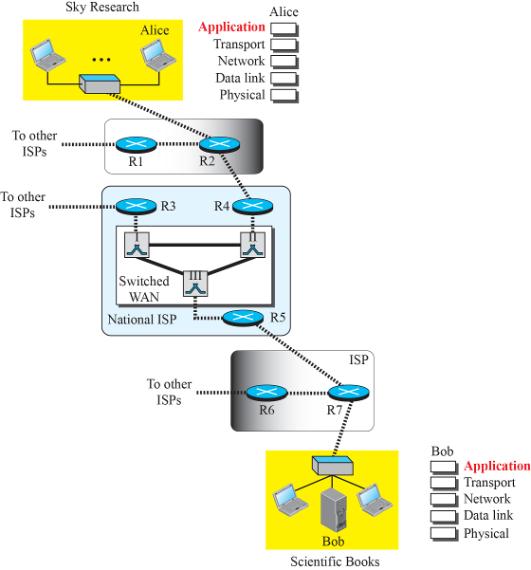
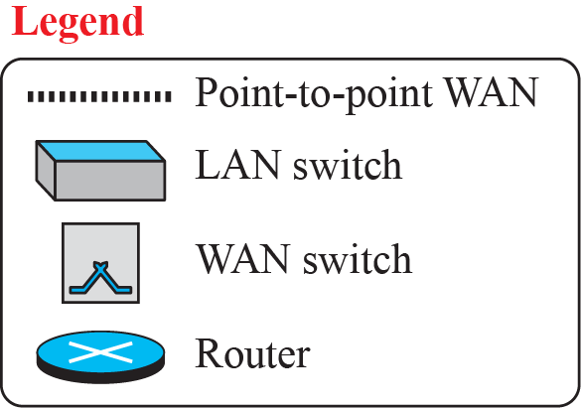

Logical connection at the application layer
Application layer
assumes that there
is a two way logical
pipe to send and
receive messages
2.4

Slide 5
Providing Services
The Internet was originally designed to provide service to users around the world.
Since the application layer is the only layer that provides services to the Internet user,
it allows new application protocols to be easily added/removed to the Internet, which has been occurring during the lifetime of the Internet.
Application layer protocols do not provide service to any other protocols.

Slide 6
Providing Services (Cont.)
Standard and Nonstandard Protocols-To provide smooth operation of the internet. (standardized)
Standard Application-Layer Protocols
Standardized and documented by internet authority.
Using them in daily interaction with the internet
Pair of computer programs that interact with the user and the transport layer to provide service to user.
- Understand what type of service they provide and how do they work

Slide 7
Nonstandard Application-Layer Protocols
Programmer can create a nonstandard application layer programs.
Write two programs to provide service to the users by interacting with the Transport layer and the programs can assume the services of the first four layers.
No need to get the permission from the Internet Authorities

Slide 8
Application-Layer Paradigm
It should be clear that to use the Internet we need two application programs to interact with each other:
one running on a one computer , the other running on another computer somewhere else in the world.
The two programs need to send messages to each other through the Internet infrastructure.
Both application programs be able to request services and provide services.
Two paradigms have been developed during the lifetime of the internet
Client-Server paradigm
Peer-to-Peer (P2P) paradigm

Slide 9
Application-Layer Paradigm (cont)
Traditional Paradigm: Client-Server
Server - provide service and runs continuously
- Client – Request for service
New Paradigm: Peer-to-Peer (P2P) E.g.: Internet Telephony
Responsibility is shared between peers
Security is a big challenge
Mixed Paradigm
- Combines the advantages of two Paradigm

Slide 10
CLIENT-SERVER PARADIGM
In this paradigm, communication at the application layer is between two running application programs called processes: a client and a server.
A client is a running program that initializes the communication by sending a request; a server is another application program that waits for a request from a client.
Lifetime of the server is infinite, Client--finite

Slide 11

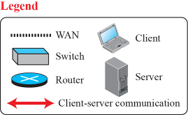
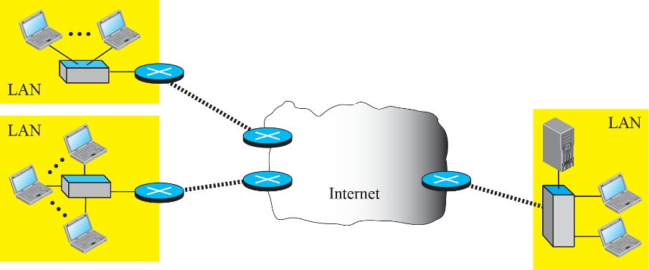
Example of a client-server paradigm
Load on the server is high

Slide 12
Client-Server paradigm
The service provider is an application program, called the server process. It runs continuously, waiting for another application program, called the client process, to make a connection through the internet and ask for service.
The server process running all the time, the client process is started when the client needs to receive service.
Ex—Telephone directory centre—server, subscriber—client (Directory centre must be ready and available all the time)
Several traditional services are still using this paradigm including WWW, HTTP(Hyper Text Transfer Protocol),FTP(File Transfer Protocol),SSH (Secure Shell), e-mail etc

Slide 13
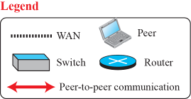
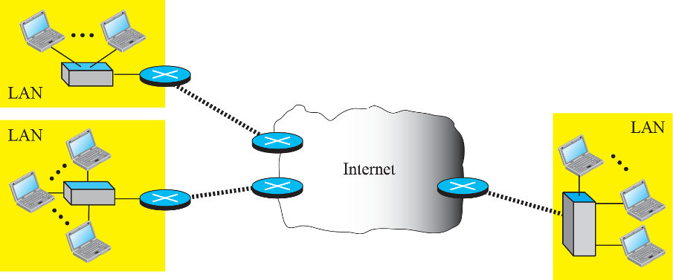
Example of a peer-to-peer paradigm
2.13

Slide 14
peer-to-peer paradigm
There is no need for a server process to be running all the time and waiting for the client process to connect.
The responsibility is shared between peers.
A computer can even provide and receive services at the same time.
Easily scalable and cost effective in eliminating the need for expensive servers to be running and maintained all the time.
Challenge –Security
New applications—BitTorrent, Skype, IPTV and internet telephony that use this paradigm.

Slide 15
Application Programming Interface
A computer language has a set of instructions for mathematical operations, for string manipulation, for input/ output access, and so on.
If we need a process to be able to communicate with another process, we need a new set of instructions to tell the lowest four layers of the TCP/IP suite to open the connection, send and receive data from the other end, and close the connection.
A set of instructions of this kind is normally referred to as Application Programming Interface (API).

Slide 16
Application Programming Interface
A set of Instructions between the process at the application layer and the Operating system that encapsulate the first four layers of the TCP/IP Protocol suite is called the Application Programming Interface (API).
Several API have been designed for communication.
Common APIs – socket interface, STREAM and Transport Layer Interface (TLI).

Slide 17
Socket Interface
The most common one, to give a general idea of network communication at the application layer.
Socket interface is a set of instructions that provide communication between the application layer and the operating system, as shown in fig.

Slide 18
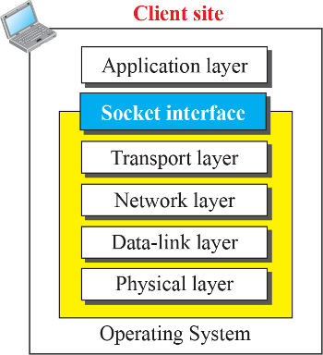
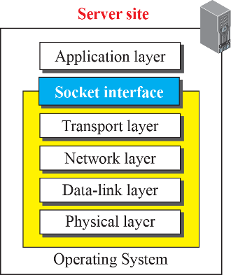
Position of the socket interface

Slide 19


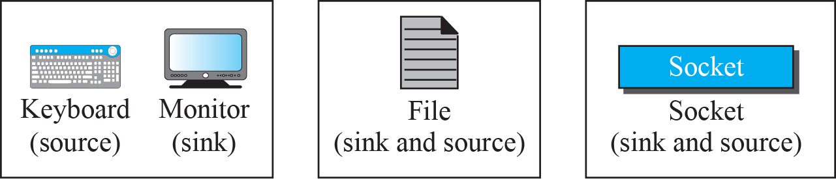
A Sockets used like other sources and sinks
Adding new type of source and sink to a programming language without changing the way we send data or receive data. Fig shows the idea and compares the socket with other sources and sinks.

Slide 20
Socket
Behave like a terminal or file, not a physical entity, it is an abstraction.
It is a data structure that is created and used by the application program.

Slide 21
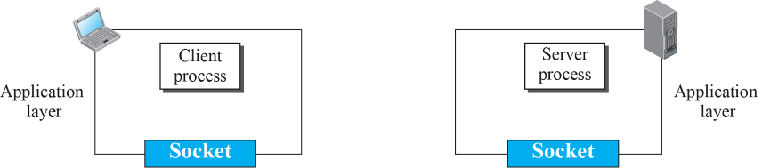
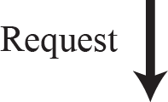
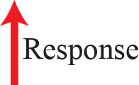
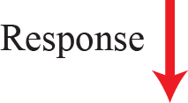
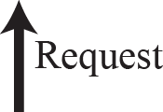

Use of sockets in process-to-process communication
Communication between a client and server process is communication between 2 sockets, created at two ends as shown in fig

Slide 22
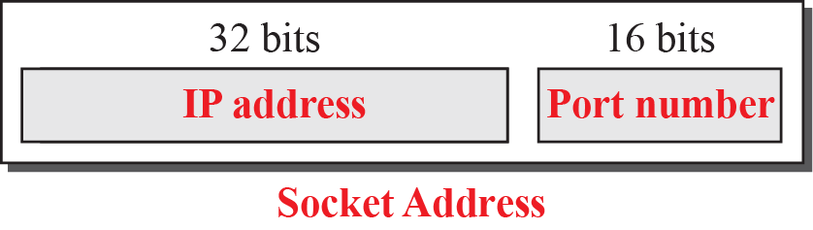
A socket address
We need a pair of socket addresses for communication . Local(sender) socket address and remote(receiver) socket address.
Computer
Process
A socket address should first define the computer on which a client or a server is running— IP Address, another identifier to define the specific client or server (process)involved in the communication— Port number.

Slide 23
Example 2.1
We can find a two-level address in telephone communication. A telephone number can define an organization, and an extension can define a specific connection in that organization. The telephone number in this case is similar to the IP address, which defines the whole organization; the extension is similar to the port number, which defines the particular connection.

Slide 24
A socket address
Server site:
Local socket address is provided by the OS
Port Number
- Standard process – assigned by Internet authorities
- Non standard process – designer choose the port number
- Remote socket address is obtained by the request packet of the client
Client site :
- Local socket address is provided by the OS
Port Number- unique temporary port number assigned by designer
Remote socket address
-a) sometimes IP and Port number is known to the client (both programs are developed by the designer)
-b) server process may have well known Port Numbers and IP is obtained using DNS(Domain Name System)
DNS maps the server name to the IP address of the computer running that server.

Slide 25
Using Services of Transport Layer
A pair of processes provide services to the users of the Internet, human or programs.
A pair of processes, however, need to use the services provided by the transport layer for communication because there is no physical communication at the application layer.
There are three common transport layer protocols in the TCP/IP suite: UDP, TCP, and SCTP.
UDP Protocol(User Datagram Protocol)
TCP Protocol(Transmission Control Protocol )
SCTP Protocol(Stream Control Transmission Protocol )

Slide 26
Using Services of the Transport Layer
UDP Protocol
connectionless, unreliable, datagram service.
Each message is an independent entity encapsulated in a packet is called a Datagram
No retransmission but looks for error detection.
UDP does not see any relation(connection) between consequent datagrams coming from the same source and going to the same destination.
Message oriented protocol and maintains message boundaries.
Analogy – service provided by post office
Ex- Some Management and multimedia applications fit in this category.

Slide 27
Using Services of Transport Layer
TCP Protocol
Connection oriented, reliable, byte-stream service
handshake (size of data packets, size of buffers etc)
Bytes are numbered
Packet is called a Segment
Provides error control, flow control and congestion control
Retransmissions possible
Analogy – service provided by the telephone company

Slide 28
Using Services of Transport Layer
SCTP Protocol
Combines the best of TCP and UDP
Connection oriented, reliable, message oriented protocol
Provides Multi-streaming and Multi-homing features .
SCTP is suitable for any application that needs reliability and remain connected.

Slide 29
STANDARD CLIENT-SERVER APPLICATIONS
During the lifetime of the Internet, several application programs have been developed. We do not have to redefine them, but we need to understand what they do.
The study of these applications can help us to create customized applications in the future.
WWW and HTTP, the most common client-server application program (used by almost all internet users).
Electronic Mail, TELNET, Secure Shell(SSH), DNS(Domain Name System).

Slide 30
World Wide Web and HTTP
World Wide Web
Architecture
Uniform Resource Locator (URL)
Web Documents
HyperText Transfer Protocol (HTTP)
Nonpersistent versus Persistent Connections
Message Formats
Conditional Request
Cookies

Slide 31
World Wide Web
The idea of Web was first proposed by Tim Berners-Lee in 1989
Goal was to share the research of different researchers at different locations of Europe.
Commercial web started in early 1990s
The Web is a repository of Web Pages distributed all over the world and the related documents are linked
To access the linked document we use the concept called hypertext

Slide 32
Architecture of the Web
It is a distributed client-server service.
In which a client using a browser can access a service using a server.
Service provided is distributed over many locations called sites.
Each site holds one or more documents called Web pages.
Each Web page could be simple(No links) or composite(one or more links to other Web pages).
Each web page is a file with a name and address.

Slide 33
Example---Assume we need to retrieve a scientific document that contains one reference to another text file and one reference to a large image. Figure shows the situation.
The main document and the image are stored in two separate files in the same site (file A and file B); the referenced text file is stored in another site (file C).
Since we are dealing with three different files, we need three transactions if we want to see the whole document.

Slide 34



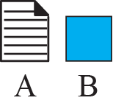


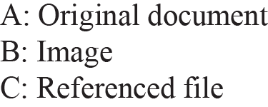





Figure 2.8: Example (Retrieving two files and one image)

Slide 35
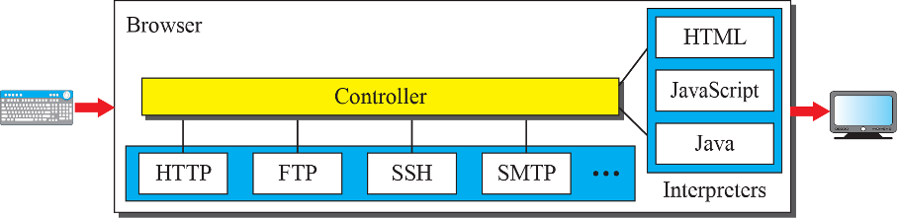
Web Client (Browser)
A variety of vendors offer commercial browsers that interpret and display a web page. Each Browser contains three parts, a Controller, client protocols and an Interpreter
The controller receives input from the keyboard or mouse and uses the client programs to access the document. Then the controller uses one of the interpreters to display the document on the screen.
Browsers – Netscape Navigator, Firefox, Internet Explorer etc.

Slide 36
Web Server
The web page is stored in the server.
For each request a corresponding document is sent to the client.
For efficiency purpose the requested web pages are stored in cache memory(faster access than disk).
Server can answer more than one request at a time.
Web servers: Apache, IIS (Internet Information Server), Nginx etc

Slide 37
Uniform Resource Locator (URL)
A Web Page ,as a file ,needs an identifier.
3 identifiers – host, port and path.
Protocol is used to tell the browser about the application we use to get the web page.
Protocol is the vehicle to fetch the web page (most of the time HTTP sometimes FTP).

Slide 38
Uniform Resource Locator (URL)
To define a web page, need 3 identifiers + Protocol
Host – could be the IP address of the server(dotted decimal notation) or the domain name.
Port – 16 bit integer (normally predefined) Eg: HTTP – 80
Path – Location and the name of the file in the underlying OS.
eg: /top/next/myfile
Url could be
protocol://host/path used most of the time protocol://host:port/path used when port number is needed
Eg--- http://www.mhhe.com/cs/forouzan.

Slide 39
Example
The URL http://www.mhhe.com/compsci/forouzan/ defines the web page related to one of the of the computer in the McGraw-Hill company (the three letters www are part of the host name and are added to the commercial host). The path is compsci/forouzan/, which defines Forouzan’s web page under the directory compsci (computer science).

Slide 40
Web Documents
The documents in the WWW can be grouped into 3 categories.
1. Static Documents – fixed contents, created and stored in a server.
Clients get a copy of the document on request.
The contents in the server can be changed but the user cannot change them.
Can be prepared using HTML, XHTML, XML, XSL (Extensible Style Language).

Slide 41
2.Dynamic Documents – Whenever a browser request for a web page, web server runs the application program/script that creates the dynamic document.
Eg: Retrieve Date and Time from server.
Use JSP or ASP
3.Active Documents – Program or script runs at client site.
Eg: Interactive programs, animated graphics.
Eg: Java applets (a compiled, ready to run program written in Java on the server), Java scripts.

Slide 42
HTTP(Hypertext Transfer Protocol)
It is a protocol used to define how client server programs can be written to retrieve web pages from the web.
An HTTP client sends a request, an HTTP server returns a response.
The server uses the port number 80, the client uses a temporary port number.
It uses TCP at the Transport layer – connection oriented, reliable protocol.
no need to worry about errors or loss of any messages(reliable).

Slide 43
HTTP
If the web pages, objects to be retrieved , are located on different servers—to create a new TCP connection for retrieving each object.
Two choices to retrieve each object
Non-persistent connection
Persistent connection

Slide 44
Non-persistent versus Persistent connection
In a Non-persistent connection, one TCP connection is made for each request/response. Following Steps in this
The Client opens a TCP connection and sends a request.
The Server sends the response and closes the connection.
The Client reads the data until EOF marker and closes the connection.
Overhead is too high (File has ‘n’ connections)

Slide 45
Non-persistent versus Persistent connection
In a Persistent connection the server leaves the connection open for more requests after sending the response.
- Server can close the connection at the request of the client or timeout occurs.

Slide 46
Example 2.4
Following figure shows an example of a nonpersistent connection. The client needs to access a file that contains one link to an image. The text file and image are located on the same server. Here we need two connections. For each connection, TCP requires at least three handshake messages to establish the connection, but the request can be sent with the third one. After the connection is established, the object can be transferred. After receiving an object, another three handshake messages are needed to terminate the connection
Non-persistent HTTP
At most one object sent over TCP connection
connection then closed
Downloading multiple objects required multiple connections
Persistent HTTP
Multiple objects can be sent over single TCP connection between client, server
HTTP version1.1 onwards it is persistent by default

Slide 47

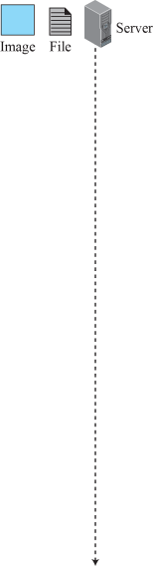
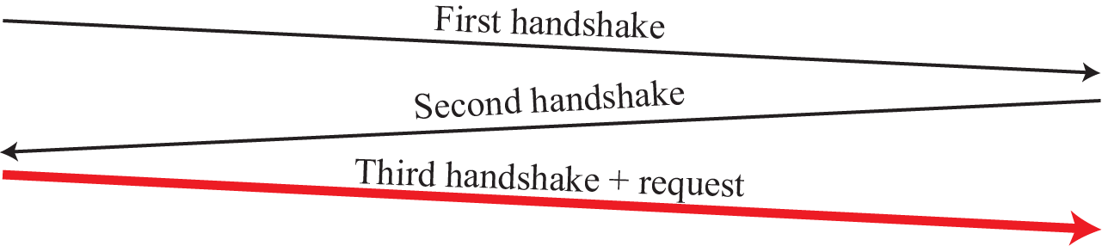

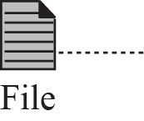
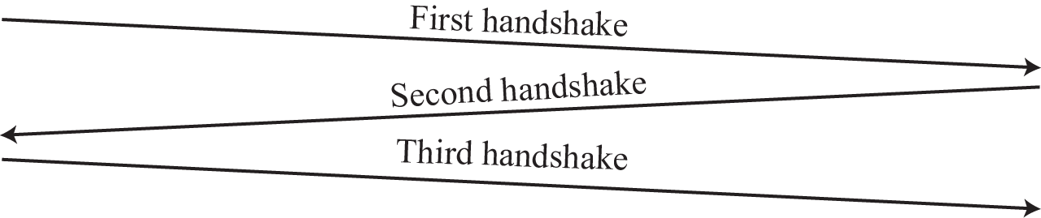

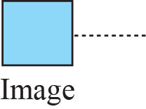
Example 2.4 non persistent connection

Slide 48
Example 2.5
Following figure shows the same scenario as in Example 2.4, but using a persistent connection.
Only one connection establishment and connection termination is used, but the request for the image is sent separately.

Slide 49
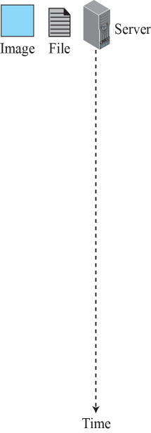



Example 2.5 persistent connection

Slide 50
Message Formats
The HTTP protocol defines the format of the Request and Response messages.
Two Formats---Each message has four sections
1. Request line / Status line
2. Header lines
3. Blank line
4. Body
Data is in clear text
Readable by humans

Slide 51
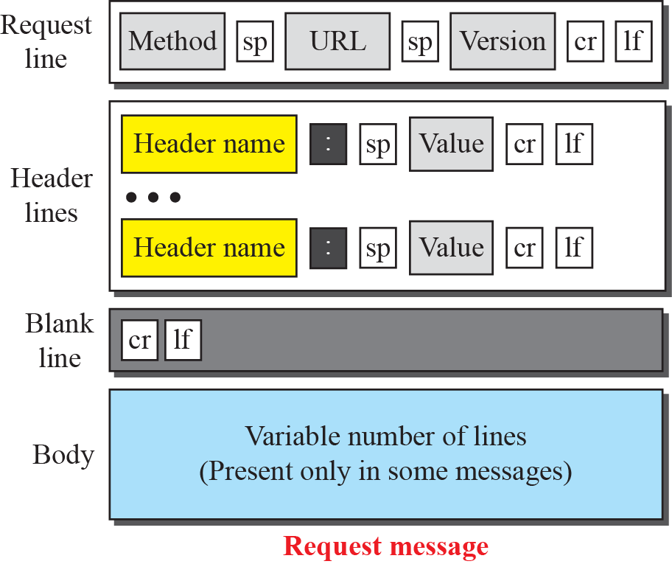
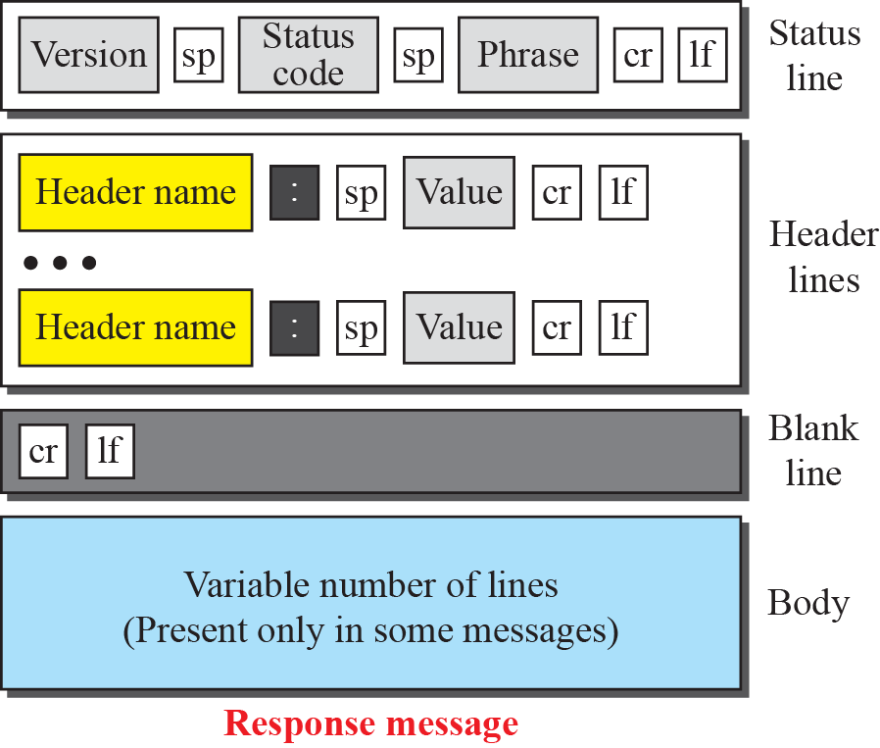
Formats of the request and response messages

Slide 52
Request Message
Method field defines the request types.
Ex—GET method to send a request.
URL – address and name of the corresponding web page.
Version – current version of the protocol, HTTP 1.1
Request header lines– 0 or more header lines, sends additional information from client to the server. Ex—document in special format.
Value field defines the values associated with each header name. found in the corresponding Request for Comments (RFC) .
Body—usually contains the comment to be sent or the file to be published on the website.(PUT/POST)

Slide 53
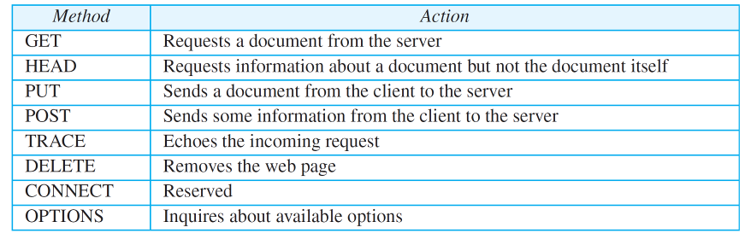
Table 2.1: Methods

Slide 54
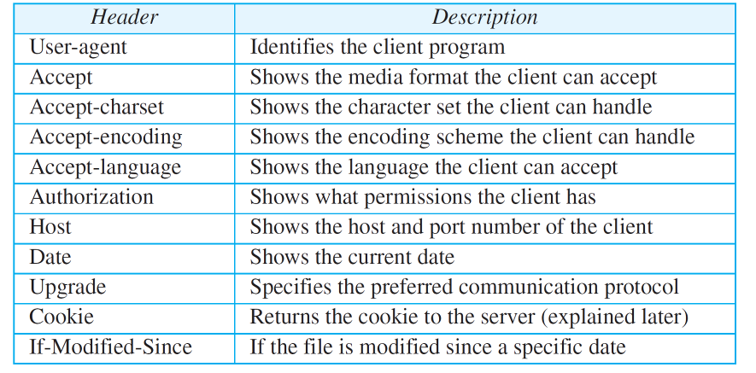
Table 2.2: Request Header Names

Slide 55
Response Message
Status code –defines the status of the request. It consists of 3 digits. 100 –500 range.
Phrase – explains the status code in text form.
Response header lines– 0 or more header lines, sends additional information from server to the client.
Body— contains the document to be sent from the server to the client. The body is present unless the response is an error message.

Slide 56
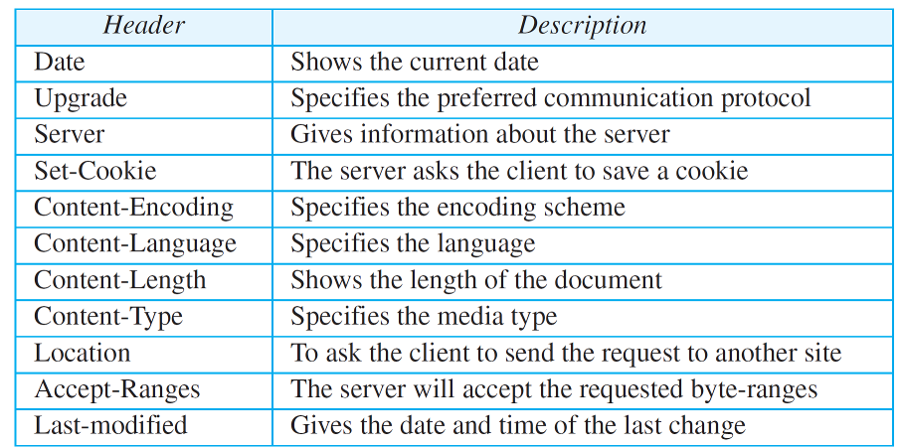
Table 2.3: Response Header Names

Slide 57
HTTP response status codes
1xx - Informational
Request received, continuing process
2xx – Successful request
Action successfully received, understood and accepted
3xx – Redirection (redirect the client to another URL)
Further action must be taken to complete the request
4xx – Error at the Client site
Request contains bad syntax or cannot be filled
5xx – Error at the sever site.
Server failed to fulfill an apparently valid request

Slide 58
HTTP response status codes
status code appears in 1st line in server-to-client response message.
some sample codes:
200 OK
request succeeded, requested object later in this msg
301 Moved Permanently
requested object moved, new location specified later in this msg (Location:)
400 Bad Request
request msg not understood by server
404 Not Found
requested document not found on this server
500 Internal Server Error
505 HTTP Version Not Supported

Slide 59
Example 2.6
This example retrieves a document (see Figure 2.13). We use the GET method to retrieve an image with the path /usr/bin/image1. The request line shows the method (GET), the URL, and the HTTP version (1.1). The header has two lines that show that the client can accept images in the GIF or JPEG format. The request does not have a body. The response message contains the status line and four lines of header. The header lines define the date, server, content encoding (MIME version, which will be described in electronic mail), and length of the document. The body of the document follows the header..

Slide 60
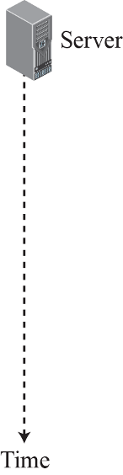
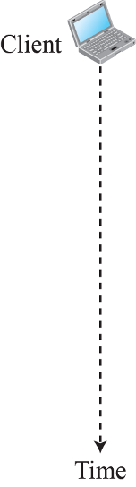
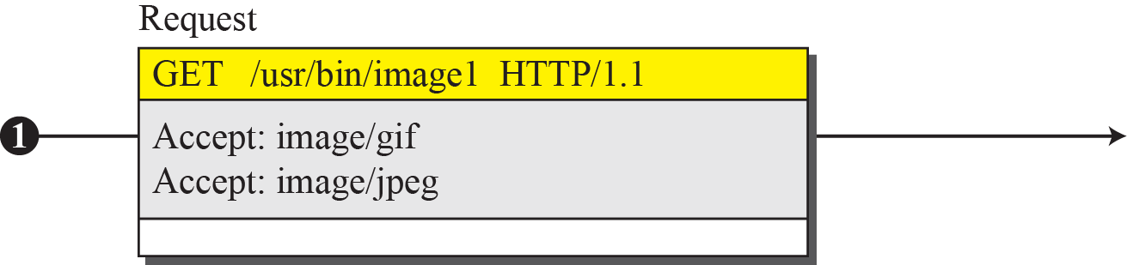
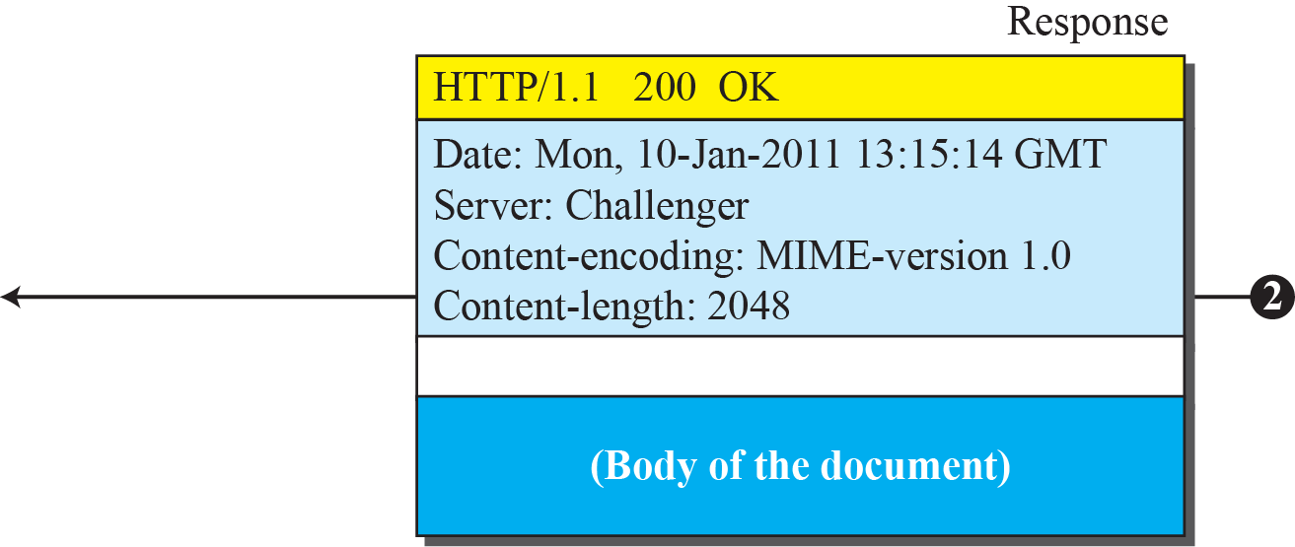
Figure 2.13: Example 2.6

Slide 61
Example 2.7
In this example, the client wants to send a web page to be posted on the server. We use the PUT method. The request line shows the method (PUT), URL, and HTTP version (1.1). There are four lines of headers. The request body contains the web page to be posted. The response message contains the status line and four lines of headers. The created document, which is a CGI document, is included as the body (see Figure 2.14).

Slide 62
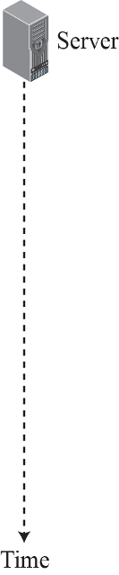
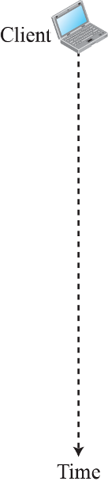
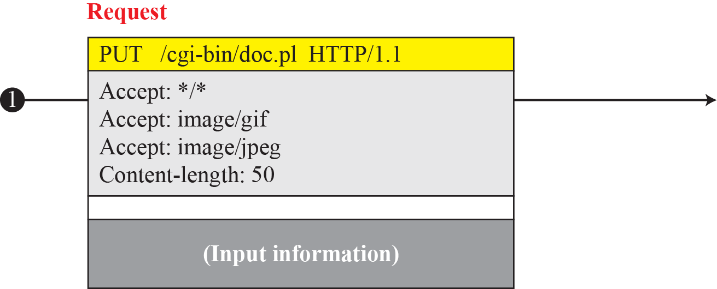
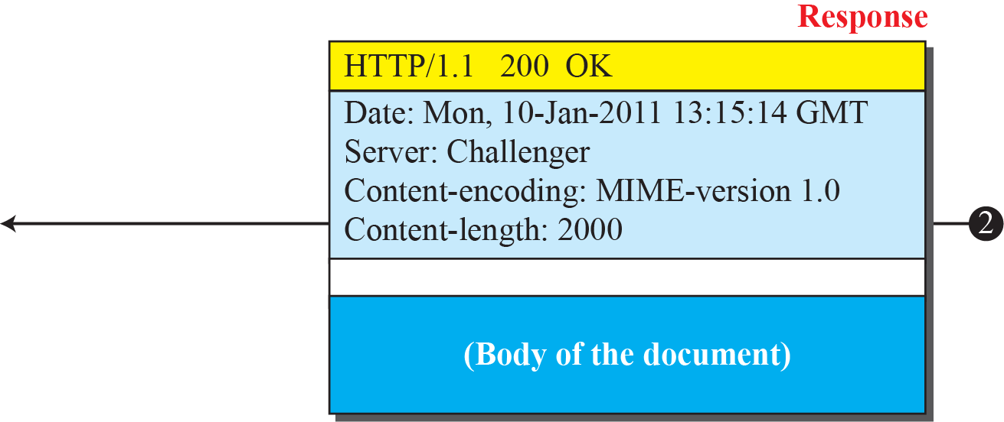
Figure 2.14: Example 2.7

Slide 63
Conditional Request
Client can add condition in its request.
Server will send the web page if the condition is met.
Most common condition imposed by the client is the time and date the web page is modified.

Slide 64
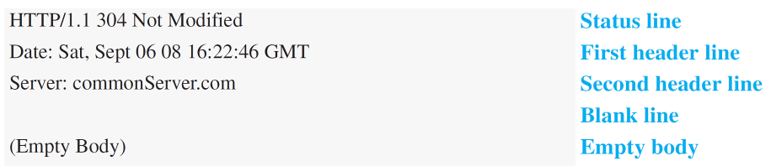
Example 2.8
The following shows how a client imposes the modification data and time condition on a request.
The status line in the response shows the file was not modified after the defined point in time. The body of the response message is also empty.

Slide 65
Stateless Protocol
Server has no information about previous request.
When client re-requests the web page
Few seconds after the previous request
Server will send the page again
Will not say that page was served just now
NOTE--The WWW was originally designed as a stateless entity. Today web has other functions that need to remember some information about the clients: some are listed below

Slide 66
Cookies
Cookie. A small text file (up to 4KB) created by a website that is stored in the user's computer either temporarily for that session only or permanently on the hard disk (persistent cookie).
Cookies provide a way for the website to recognize you and keep track of your preferences.
It is information for future use that is stored by the server on the client side of a client/server communication.

Slide 67
Cookies
Websites are being used a electronic stores that allow users to browse though the sites, select wanted items, put them in an electronic cart.
Some websites need to allow access to registered clients only.
Some websites are used as portals.
Some websites are just advertising agency.

Slide 68
Creating and storing Cookies
Depend on the implementation.
1.When the server receives the request from the client, it stores info about client like domain name, registration No. etc in a file or string(creating cookie).
2.The Server includes the cookie in the response that it sends to the client.
3. When the client receives the response ,the browser stores the cookie in the cookie directory, which is stored by the server domain name.

Slide 69
Example 2.9
Figure shows a scenario in which an electronic store can benefit from the use of cookies. Assume a shopper wants to buy a toy from an electronic store named BestToys. The shopper browser (client) sends a request to the BestToys server. The server creates an empty shopping cart (a list) for the client and assigns an ID to the cart (for example, 12343). The server then sends a response message, which contains the images of all toys available, with a link under each toy that selects the toy if it is being clicked. This response message also includes the Set-Cookie header line whose value is 12343. The client displays the images and stores the cookie value in a file named BestToys.

Slide 70
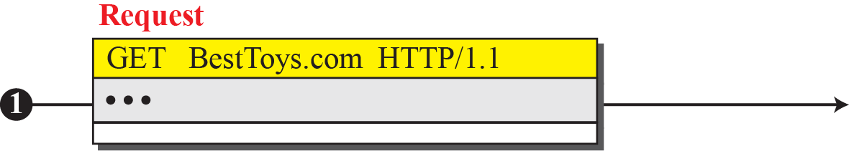
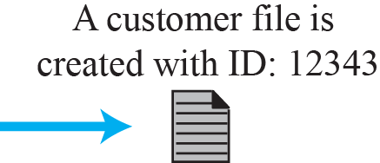
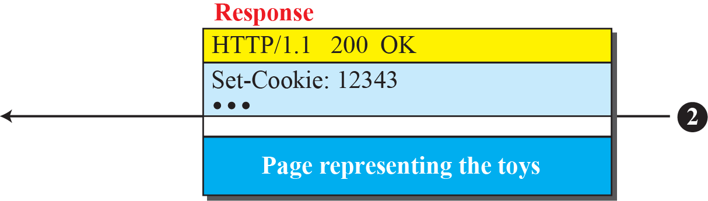



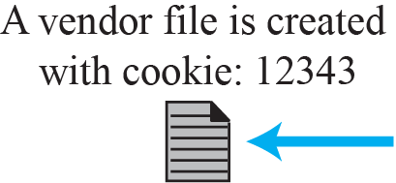


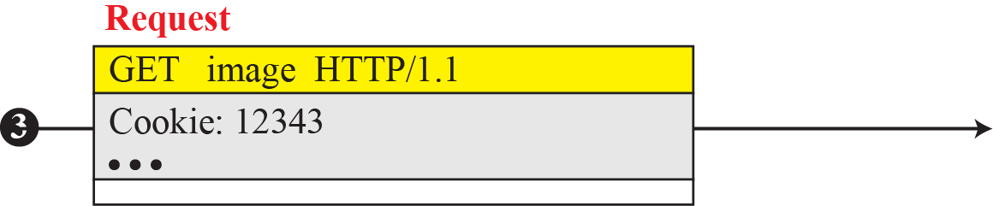
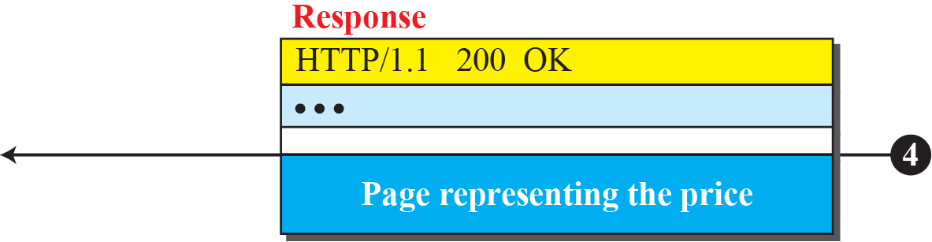
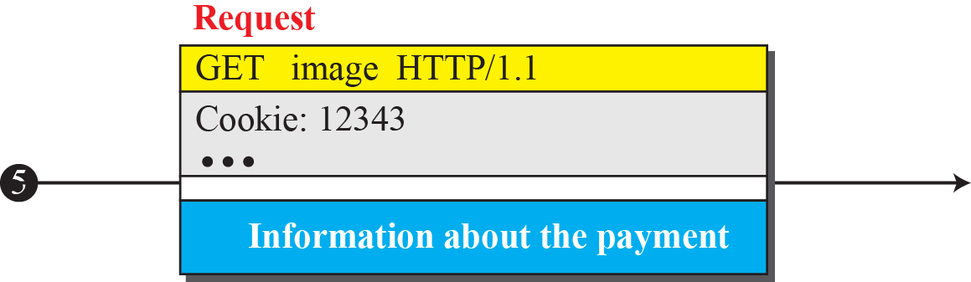
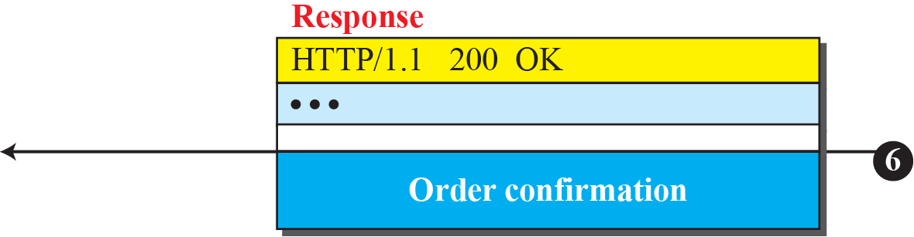
Figure : Electronic store can benefit from the use of cookies.

Slide 71
Web Caching :Proxy Server
HTTP supports proxy server.
A proxy server is a computer that keeps copies of responses to recent requests.
The HTTP client sends a request to the proxy server. The proxy server checks its cache.
If the response is not stored in the cache, the proxy server sends the request to the corresponding server.
Incoming responses are sent to the proxy server and stored for future requests from other clients.
Acts as both client and server.

Slide 72
Proxy Server
It reduces the load on the original server, decreases traffic and improves latency.
However, to use the proxy server, the client must be configured to access the proxy instead of the target server.
Normally located at the client site.

Slide 73
Example
Figure shows an example of a use of a proxy server in a local network, such as the network on a campus or in a company. The proxy server is installed in the local network. When an HTTP request is created by any of the clients (browsers), the request is first directed to the proxy server If the proxy server already has the corresponding web page, it sends the response to the client. Otherwise, the proxy server acts as a client and sends the request to the web server in the Internet. When the response is returned, the proxy server makes a copy and stores it in its cache before sending it to the requesting client.

Slide 74
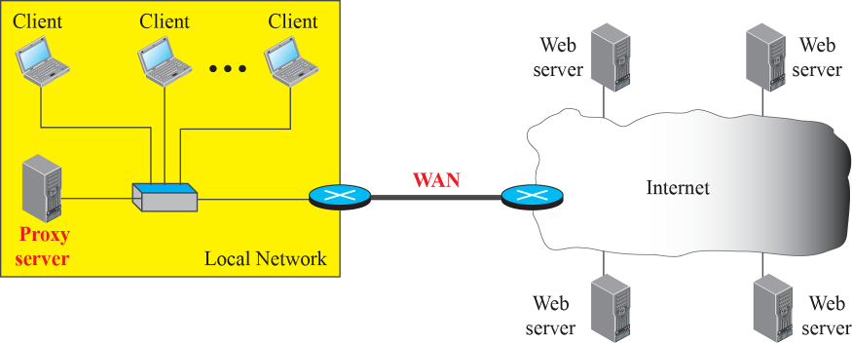
Figure : Example of a proxy server

Slide 75
How long the response should remain in proxy?
Different strategies are used
Eg: news page everyday early morning access and keep it until next day
Add different headers (to give more info)
HTTP Security – HTTP no security, if required use HTTPs.
HTTP can be run over the Secure Socket Layer(SSL). In this case, HTTP is referred to as HTTPS.
HTTPS provides confidentiality, client and server authentication and data integrity.

Slide 76
File Transfer Protocol-- FTP
File Transfer Protocol (FTP) is the standard protocol provided by TCP/IP for copying a file from one host to another.
Although transferring files from one system to another seems simple and straightforward, some problems must be dealt with first.
For example, two systems may use different file name conventions. Two systems may have different ways to represent data. Two systems may have different directory structures.
All of these problems have been solved by FTP in a very simple and elegant approach.

Slide 77
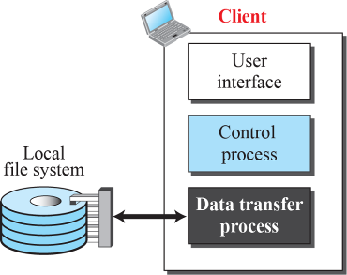
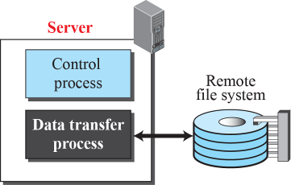
Basic Model of FTP
Client – 3 components
Server – 2 Components
Separation of commands and data transfer makes FTP more efficient
Communication is through commands and responses

Slide 78
Lifetime of Two connections
Control connection remains open for entire interactive FTP session.
The Data connection is opened and closed for each file transfer activity.
Port 21 – control connection
Port 20 - data connection

Slide 79

FTP operations: separate control, data connections
FTP client contacts FTP server at port 21, using TCP
client authorized over control connection
client browses remote directory, sends commands over control connection
when server receives file transfer command, server opens 2nd TCP data connection (for file) to client
after transferring one file, server closes data connection
Control connection remains open for entire session
server opens another TCP data connection to transfer another file
TCP control connection,
server port 21
FTP
client
TCP data connection,
server port 20
FTP
server

Slide 80
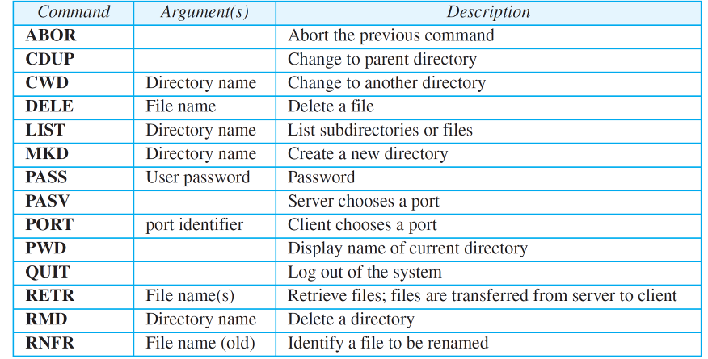
Control connections
Table 2.4: Some FTP commands

Slide 81

Table 2.4: Some FTP commands (continued)

Slide 82

Table 2.5: Some responses in FTP
Every FTP command generates atleast one response – three digit number followed by text

Slide 83
Communication over data connection
The client define the type of the file, structure of the data and transmission mode using control connection (prepare for transmission).
File type could be ASCII (A), EBCDIC (E) or image (I) file
Data structure could be a file structure (stream of bytes), record structure (file divided into records) or page structure (file is divided into pages with page No. and page header)
Transmission mode could be stream mode, block mode or compressed mode
Now file transfer can occur using data connection – retrieving a file, storing a file or directory listing

Slide 84
Example 2.11
Following figure shows an example of using FTP for retrieving a file. The figure shows only one file to be transferred. The control connection remains open all the time, but the data connection is opened and closed repeatedly. We assume the file is transferred in six sections. After all records have been transferred, the server control process announces that the file transfer is done. Since the client control process has no file to retrieve, it issues the QUIT command, which causes the service connection to be closed.

Slide 85







Example

